Slide 1


Joint Channel and Power Optimization in Soft Video Delivery
Ticao Zhang and Shiwen Mao
School of Electrical and Computer Engineering
Auburn University
Auburn, AL 36849-5201
Progress Report to the FiWIN IAB

Slide 2
Outline
Project review
Background
Quad Chart
Project report
Work1: Metadata reduction for soft video delivery
Work2: Joint power and channel resource optimization for soft video delivery
Future Plan
Resource optimization in multi-view soft video delivery
Tasks and schedule

Slide 3
Project review
Background
Overview of Digital video delivery

Slide 4
Project review
Background
Overview of Soft video delivery

Slide 5
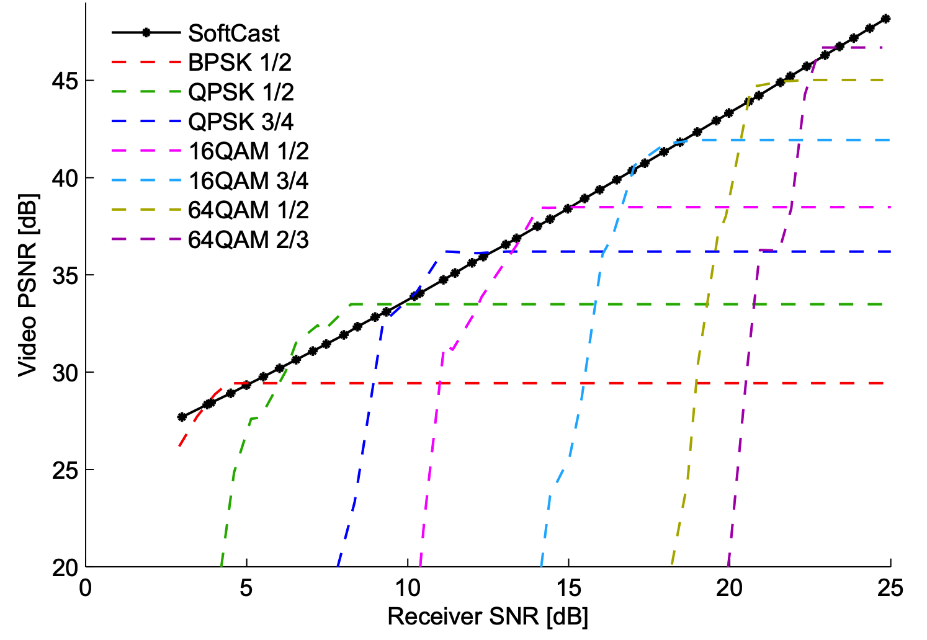
Project review
Background
Digital video transmission vs Soft video transmission
Digital video transmission | Soft video transmission
Separate source and channel coding | Joint source and channel coding
Suffer from cliff effect | Graceful video quality degradation
Complex bit-rate control | Simple bit-rate control
Jakubczak, S., & Katabi, D. (2011). Softcast: one-size-fits-all wireless video. ACM SIGCOMM Computer Communication Review, 41(4), 449-450.

Slide 6
Project review
Joint Channel and Power Optimization in Soft Video Delivery
Quad chart
Motivation and Background
System Diagram
Contemporary digital video transmission
Separate channel coding and source coding
Vulnerable to bit errors
Hard to adapt to channel quality variation
Soft video delivery (SoftCast)
Joint channel and source coding
Graceful video quality degradation
System framework
To exploit the full potential of SoftCast
Signal energy distribution (SED) should be modeled
The overhead of metadata should be reduced
A cross-layer joint resource optimization
…
A MU-MIMO extension
Proposed soft video delivery system employing blind detection for improved quality and reduced cost.
Novelty and Technical Approaches
Tasks and Schedule
Tasks | Schedule
 | H1 | H2 | H3 | H4
Investigation of an accurate signal detection algorithm with reduced metadata
Investigation of theoretical performance for power-distortion optimization
Investigation of power and bandwidth usage tradeoff in a SISO soft video delivery system
Investigation of joint power and bandwidth allocation in a multi-view soft video delivery system
The proposed blind data detection algorithm which is simple and almost metadata-free
A semi-analytical model is derived to evaluate the joint effect of bandwidth and power re-allocation in a SISO fading channel. The developed model can predict the QoE of the users accurately and hence assist the resource optimization in a MU-MIMO system
We extend the current SoftCast to a MU-MIMO system where the system can allocate resources based on the users’ requirement and the channel conditions. This is a cross-layer design.
Budget: 1.5 GRAs, $25,000/Year
6

Slide 7
Project report
Work1: Metadata reduction for soft video delivery
System model
Challenges
Proper signal energy distribution
metadata overhead reduction
Proposed solution
Recover the video signal from the
squared amplitude of the signals
The transmitter optimally scales each
DCT coefﬁcient so that the distortion
caused by the improper power scaling
can be eliminated
Almost metadata-free

Slide 8
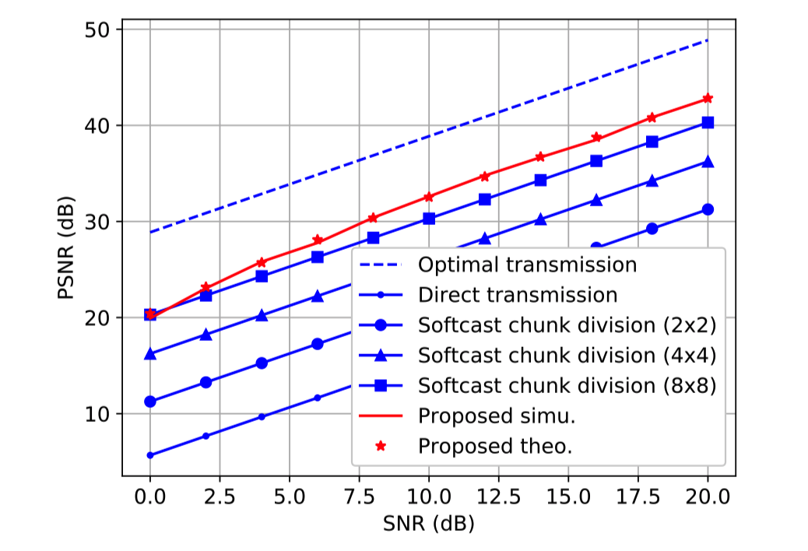
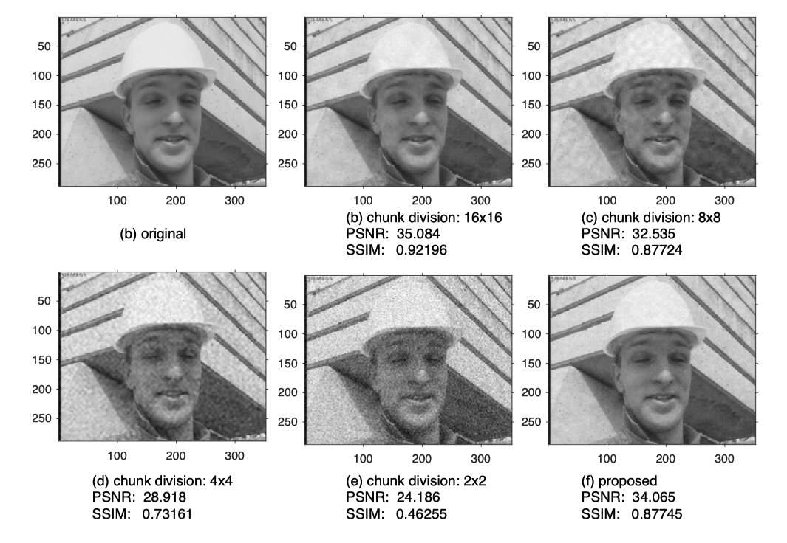
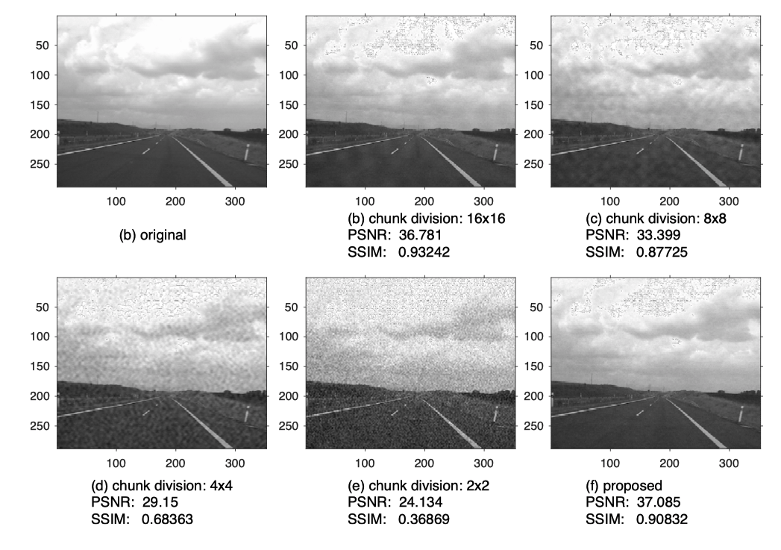
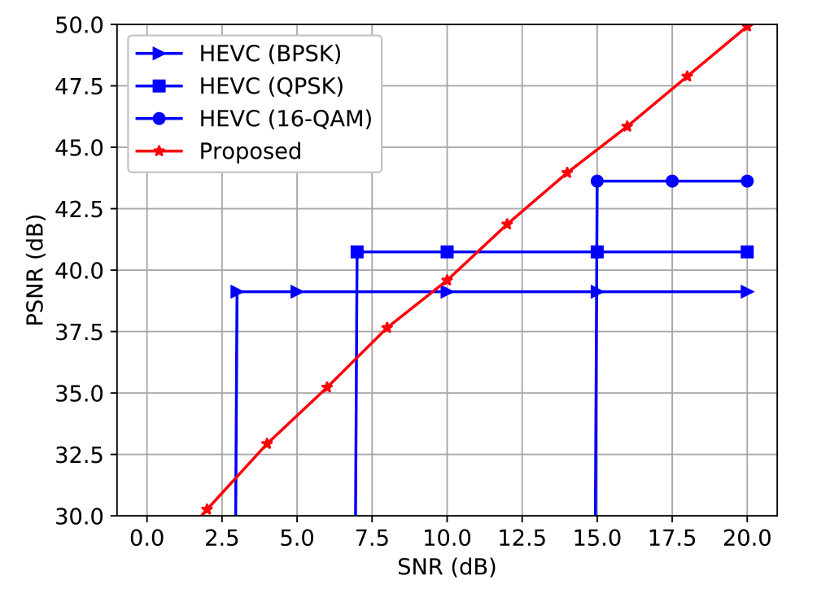
Project report
Work1: Metadata reduction for soft video delivery
Overhead reduction
Comparison with digital solutions
Video quality comparison

Slide 9
Project report
Work2: Joint power and channel resource optimization for soft video delivery
System model
Challenges
is discrete number, is continuous number
Mixed integer non-linear programming (NP-hard)
Proposed solution
Discard low-priority chunks, retain high-priority chunks in a greedy way
Optimal power allocation with Lagrange multiplier method
Energy of each chunk
Channel use budget
Power use budget

Slide 10
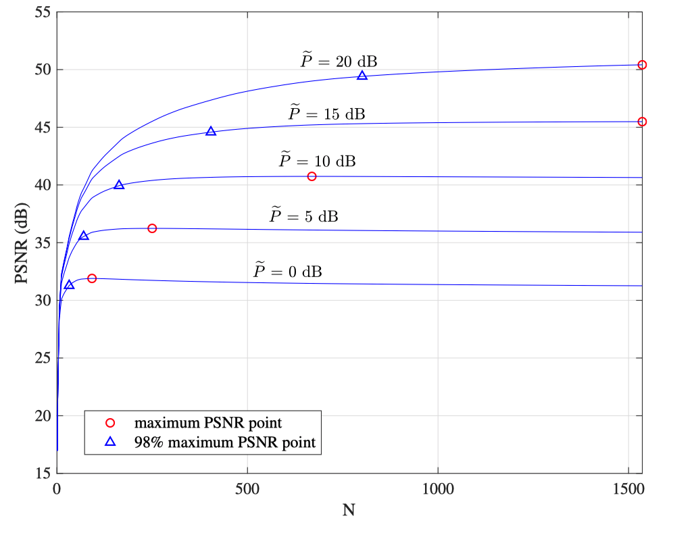
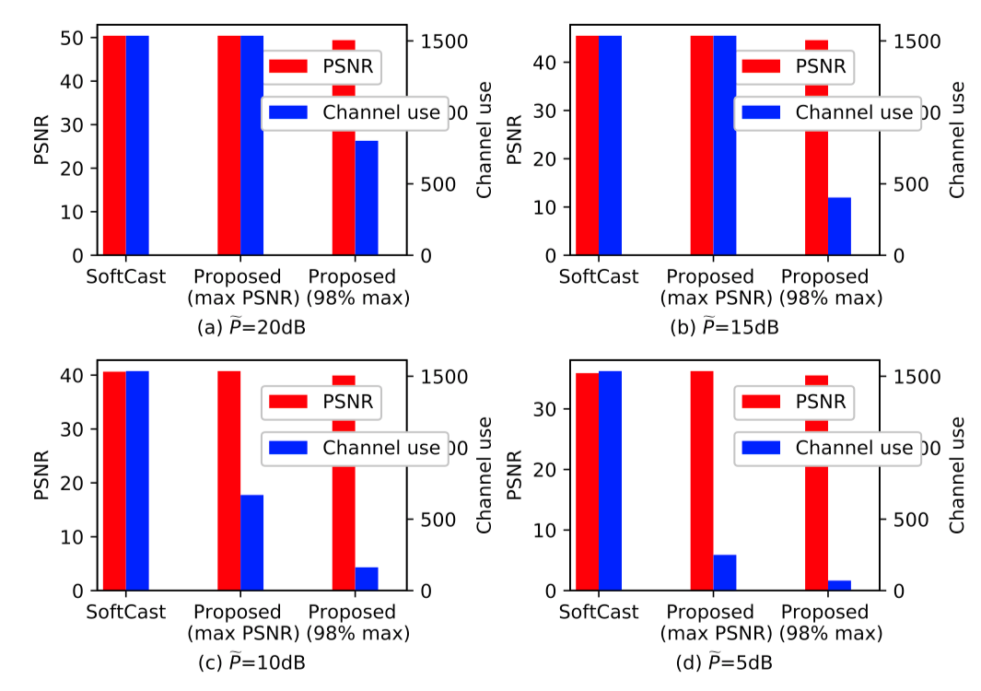
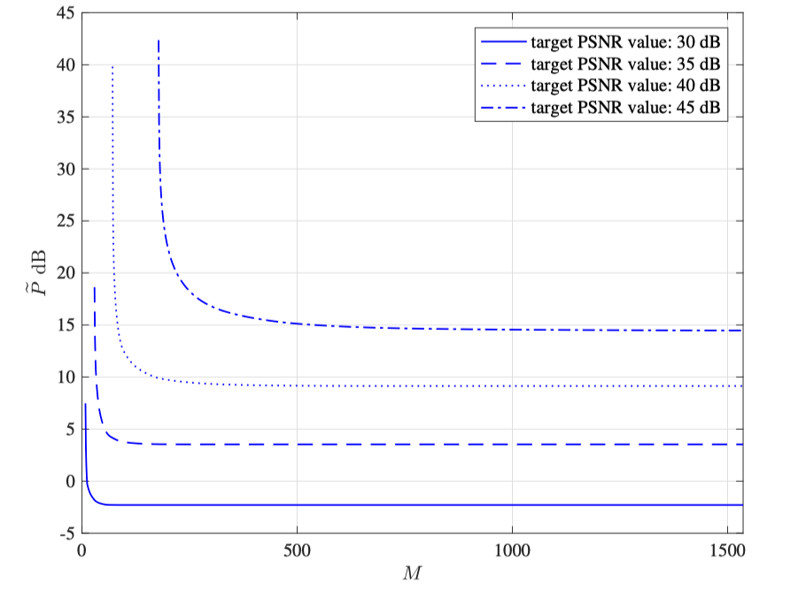
Project report
Work2: Joint power and channel resource optimization for soft video delivery
Distortion resource optimization
Channel and power usage tradeoff curve
Channel usage saving

Slide 11
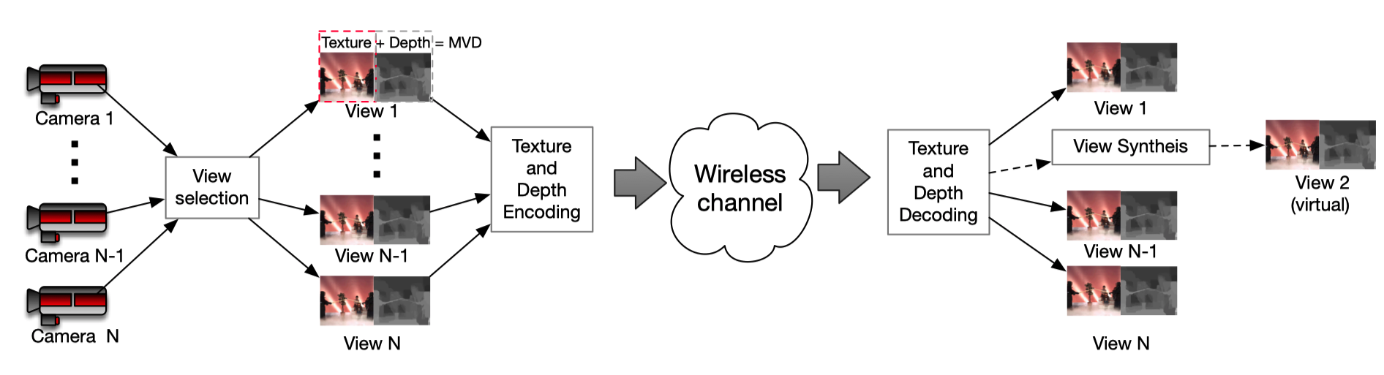
Future Plan
Resource optimization in multi-view soft video delivery
Challenges 1: the video data grows linearly with the product of cameras and the number of frames depths. (huge data overhead problem)
Challenges 2: The impact of power control across texture and depth frame needs to be investigated
System diagram

Slide 12
Conclusion
Advantages of soft video delivery
Video quality scales gracefully with the channel quality
Cliff effect can be eliminated
Joint channel and source coding
Resource control method
Metadata overhead: efficient metadata reduction method
Video data overhead: discard lower priority data and retain high priority data
Efficient channel and power usage control algorithm
Future work on multi-view video transmission
Optimal power control on across texture and depth data for each frame
Optimal power control on view synthesis across different frames
FPGA implementation

Slide 13
Schedule and Tasks
Tasks | Schedule
 | H1 | H2 | H3 | H4
Investigation of an accurate signal detection algorithm with reduced metadata
Investigation of the theoretical performance for power-distortion optimization
Investigation of power and bandwidth usage tradeoff in a SISO soft video delivery system
Investigation of joint power and bandwidth allocation in multi-view soft video delivery system
Budget: (1 year) $25,000
Manpower: 1 GRA
13

Slide 14
Thank You! Email: smao@ieee.org

